Slide 1
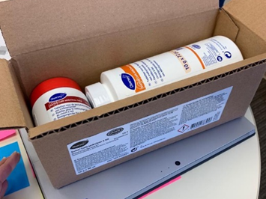
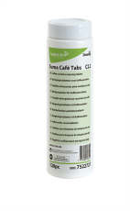
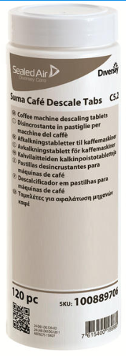
Version 10-03-2026
Overview cleaning / descaling products
Commodity code to be used for cleaning materials: 34029090
 | SAP Number and Product name | Product description | Picture/vendor material number
 | 55121307 (phase out 17-1-2025)/4016974 TP SUMA CAFÉ AUTOTAB 60PC C1.7 X2 | Cleaning tabs for Espresso equipment | 101100859
 | 55121308/4056510 TP SUMA CAFÉ MiLK CL TABL KIT C3.7X1 | Cleaning tabs for Milk system (L’OR SUPRÊME) Milk fats can be removed with alkaline cleaners (big pot) and milk particles with acidic cleaners (small pot). | 101102051
 | 55116055/4016975 TP SUMA CAFÉ TAB 120PC C2.2 X2 | Cleaning tabs for Vending equipment Phosphate free cleaning tab for Vending and filter equipment. | 100912198
 | 55117860/4061314 SUMA DESCALE TABS C5.2 2X120PCS | SUMA DESCALE TABS C5.2 2X120PCS (L’OR SUPRÊME) | 100889705
Diversey cleaning/descaling products

Slide 2
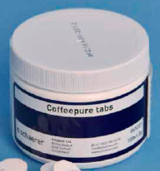
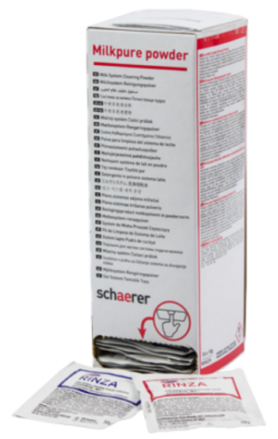
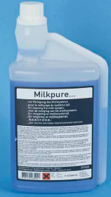
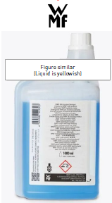
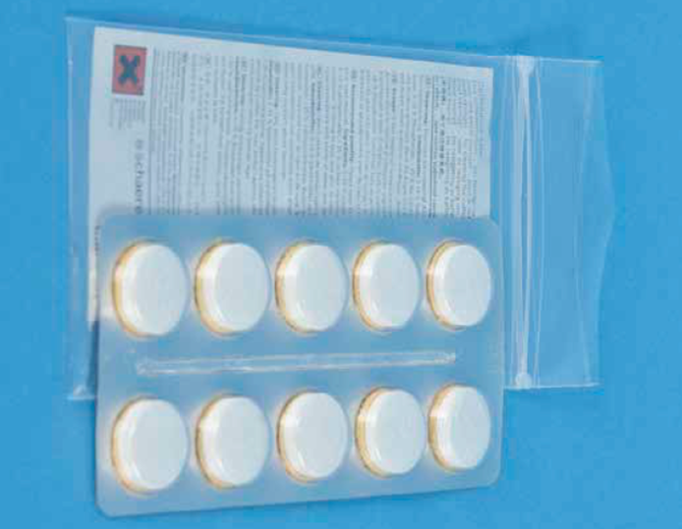
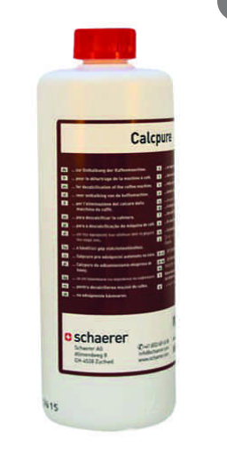
 | SAP Number and Product name | Product description | Picture/vendor material number
 | 55115084/4061930 CLEANING TABLETS 100 PCS | Tablet for daily cleaning of traditional and automatic Espresso equipment. Suitable for Schaerer, WMF and Franke. | Old 065221 New 3370065221
 | 55121745/4061744 Milkpure powder 1 Box 4057657 | Milkpure powder 1 Box (SCS, Schaerer SOUL 10-12 and Schaerer Coffee Skye) Milk fats can be removed with alkaline cleaners, and milk particles with acidic cleaners. The Milkpure powders contains both alkaline and acidic sachets, optimising milk system cleaning. The alkaline and acidic cleaners can be differentiated by colour. | old 075351 New 3370075351
 | 55128400/4008445 55001271/4061932 4071964 MILKPURE 1000 ML | SPECIAL CLEANING LIQUID # MILK Cleaning liquid for Milk system Schaerer Coffee Club | 3345340000 old 071530 New 3370071530
 | 6286700 TP SCHAERER KAM CLEANER TABL+SP 10PC X Replacement:55115048/4061930 55026997 CL.TABLET 1X10-PACK BLIST.1.3G | TP SCHAERER KAM CLEANER TABL+SP 10PC X Can also be used for Evoca Z3000 and Z4000 brewer cleaning (Omni, Kometa) CL.TABLET 1X10-PACK BLIST.1.3G | old 062867 new 3370062867
 | 4057641 - TP SCHAERER LIQ SCALE REMOVER 2PC X1 55097081/4061931 LIQUID SCALE REMOVER 4057641 | liquid scale remover Schaerer Coffee Club | old 062869 New 3370062869
Schaerer cleaning/descaling products

Slide 3
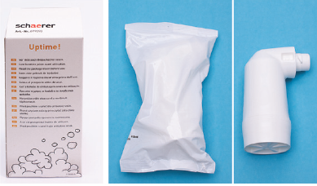

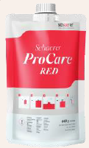
 | SAP Number and Product name | Product description | Picture/vendor material number
 | 55118117/4061101 Descaling cartridges | Descaling cartridges for Schaerer SOUL and SKYE. | old 079293 New 3370079293
 | 55126376/4057312 CLEANING BAG PROCARE BLUE 600G | Cleaning pouch BLUE for Procare | old 101044 New 3370101044
 | 55126377/4057311 CLEANING BAG PROCARE RED 600G | Cleaning pouch RED for Procare | old 101045 New 3370101045
Schaerer cleaning/descaling products

Slide 4
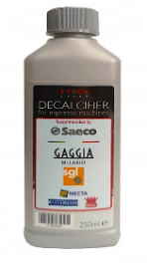
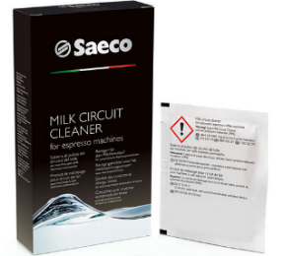
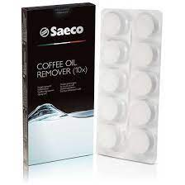
 | SAP Number and Product name | Product description | Picture/vendor material number
 | 55119528/4057716 Acc NW Descaler 1U ROW 250ml | Descale liquid for Saeco / Evoca | 21002666
 | 55126451/4057068 Milk cleaning powder - 6 pb | Sachets for milk cleaning Seaco | 21002662
 | 55126450/4057067 Coffee oil remover tablets | Cleaning tabs for Saeco | 21002663
Evoca cleaning/descaling products

Slide 5
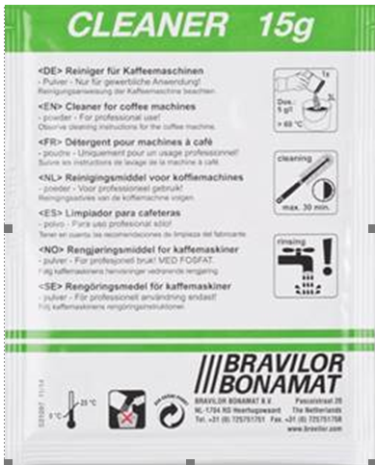
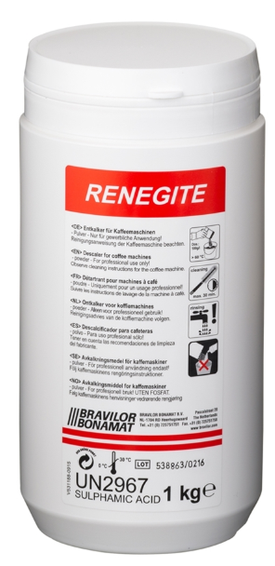
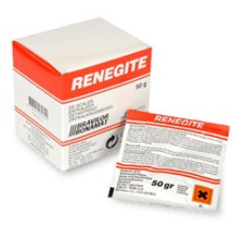
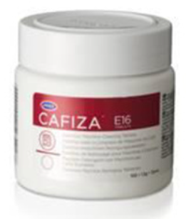
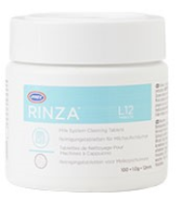
 | SAP Number and Product name | Product description | Picture/vendor material number
 | 55121462/4242837 CLEANER (4X15 SACHETS OF 15 GR) | CLEANER (4X15 SACHETS OF 15 GR) | 7.191.101.212
 | 55116892 RENEGITE 1 KARTON 10 x 1 KG | RENEGITE 1 KARTON 10 x 1 KG | 7.190.102.201
 | 55116395/39700 RENEGITE DECALC 15X50G X4 | RENEGITE DECALC 15X50G X4 | 7.190.101.212
 | 55123901 CAFIZA E16 POT 100PCS A 1,2GR 4061280 TP CAFIZA CLEANING TABLETS 100PC X12 | CAFIZA E16 POT 100PCS A 1,2GR | 7.193.101.101
 | 55115573/4055137 FDSOT RINZA CLEANING TABLETS 100PC X1 (Bravilor) | FDSOT RINZA CLEANING TABLETS 100PC X1 Cleaning tabs for Promesso | 7.193.301.102
Bravilor cleaning/descaling products

Slide 6
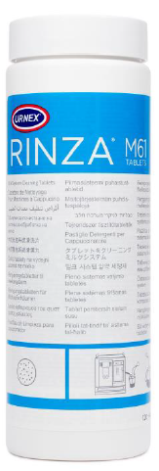
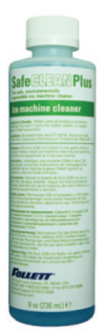
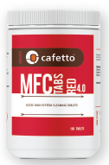
 | SAP Number and Product name | Product description | Picture/vendor material number
 | Expected phase-out from JDE Central Stock: 55060967: Oct 1st 2025. 4025909 : Jan 1st 2026 55060967/4025909 RINZA M61 CLEANING TABLETS 120PC X1 (Urnex) | Cleaning tabs for Excellence/NG120/Sprso | 12-M61-UX120-12
 | 55125979 SAFECLEAN PLUS ICE MACHINE CLEANER (Follet) | Cleaner liquid for Follett E7 ICE machine | 001149962
 | 55128297/4009901 CAFETTO MFC RED 4.0 CLEANING TABS (Cafetto) | Cleaning tabs for Excellence/NG120/Sprso | E18643
 | BACK UP IN CASE CAFETTO CAN’T DELIVER 55128424 MILK SYSTEM CLEANING TABLETS 120PCS (Lujo) | Cleaning tabs for Excellence/NG120/Sprso | 83005
Urnex & Follet & Cafetto cleaning/descaling products

